Slide 1

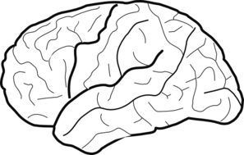
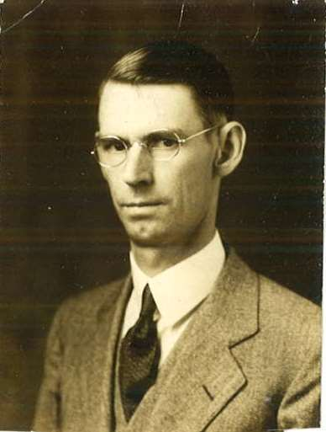
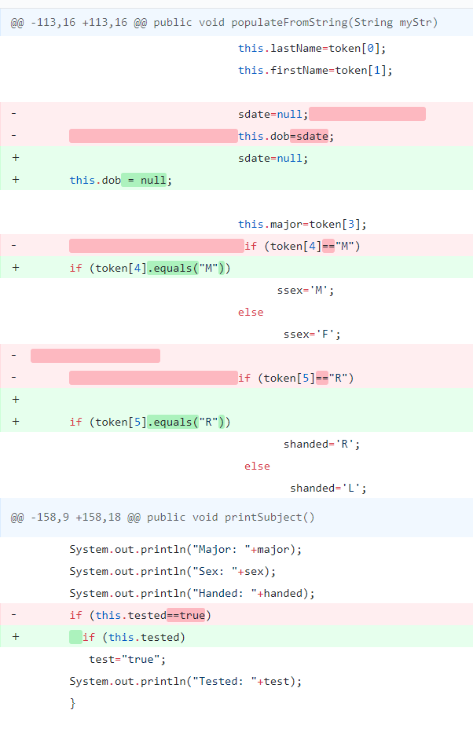
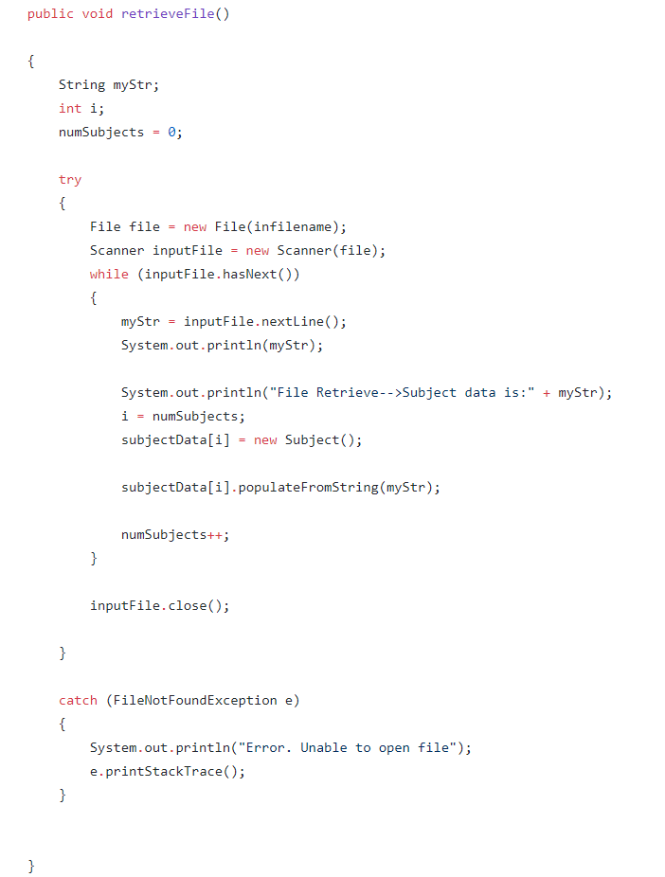
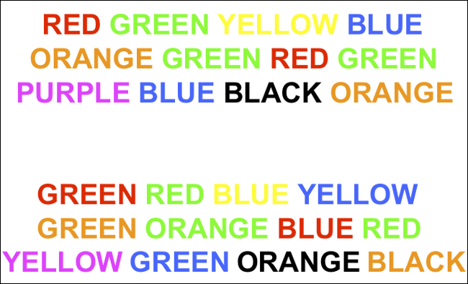
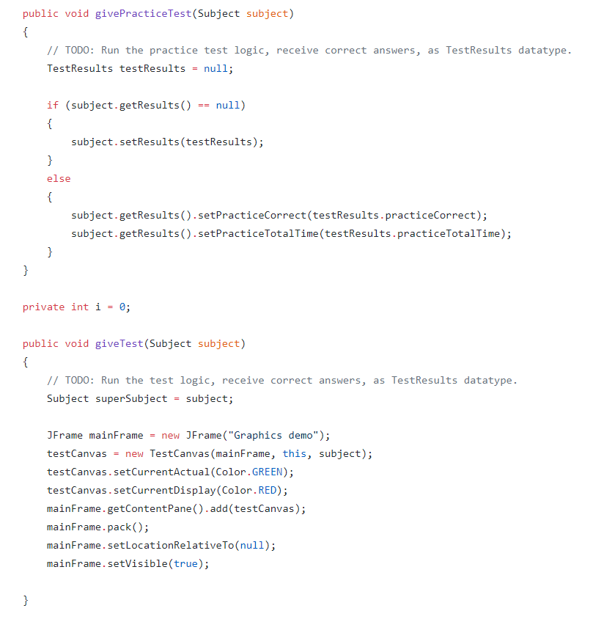
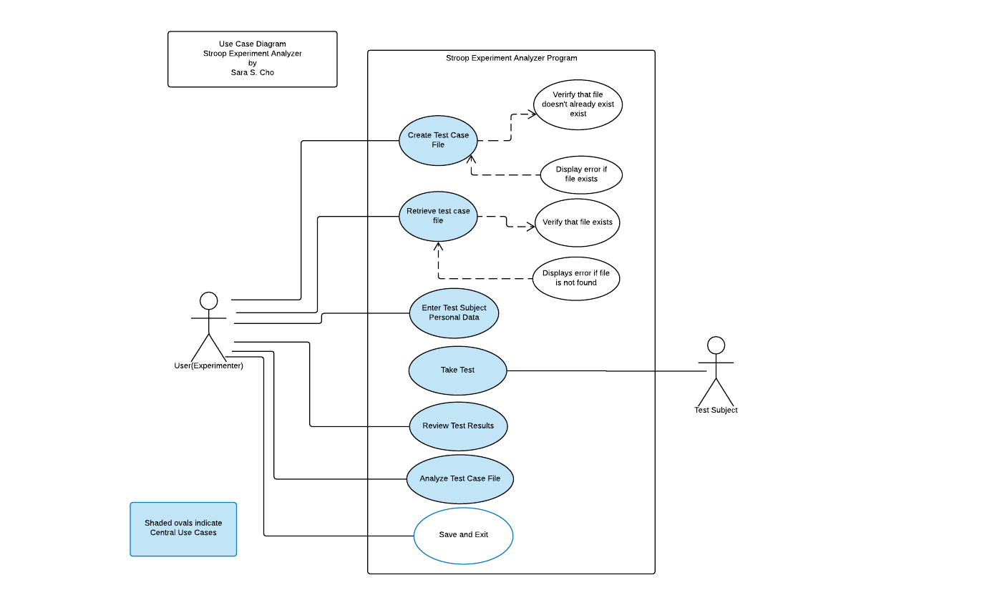
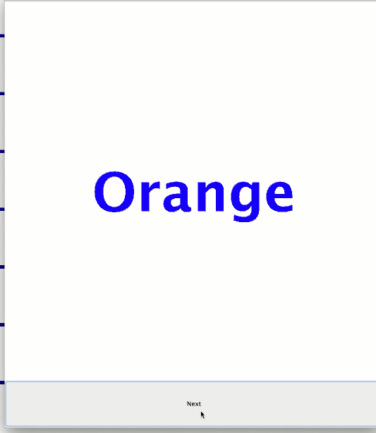
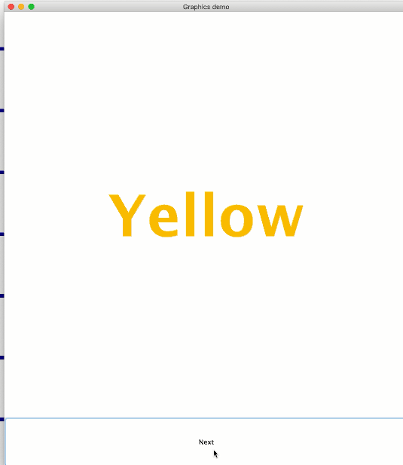
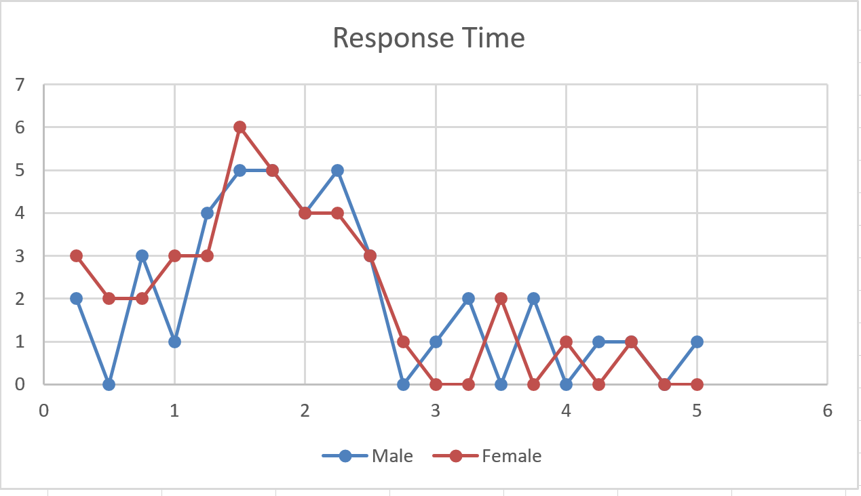
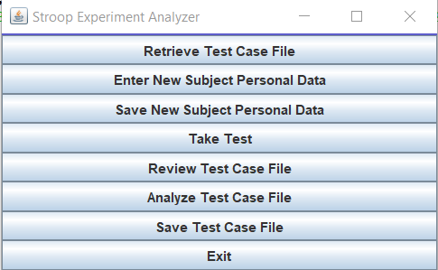
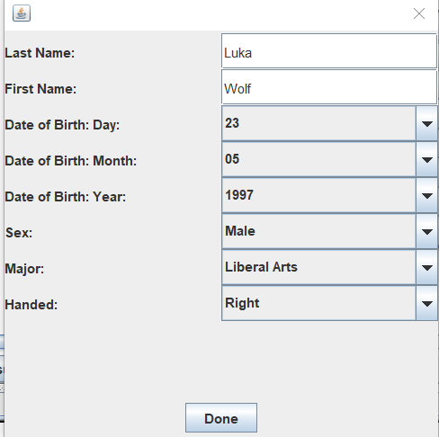
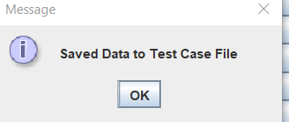
The Effect of Irrelevant Stimuli on Attention
Designing and Utilizing Java Programming to Distribute
the Stroop Test to Collect Stroop Effect Data
By: Sara Cho, Robert Varadan, Katherine McCusker, and Nik Calias
Abstract
Materials and Methodology
Samples of Code
Conclusion
What is the Stroop Effect and how do we test for it?
The Stroop Effect is an effect originally studied by
J. R. Stroop, using a task in which a person is instructed
to respond to one aspect of a stimulus, such as the color
of ink that a word is printed in, and ignore another
aspect, such as the color that the word names. Stroop
demonstrated that a person’s attention can be distracted
from a task by a task irrelevant stimuli.
Why is this experiment important?
Stroop’s experiment is important because in today’s society we are exposed to growing amounts of information. Psychologists, computer scientists, as well as businessmen need to understand how multiple sources of information can impact the a person’s ability to pay attention.
The IDE IntelliJ and Java code were utilized in the creation of the test. In order to create this emulation, the code is split into several major parts:
The Data Manager: DataManager is the most important portion of the code. This read and writes the data that the user provides to the program such as their identifying information (name, birthday, etc.) as well as their test results. This class is connected to and utilizes the other major classes in addition to some of the smaller classes such as Subject and TestResults.
Examiner:
The Examiner provides the user/subject with the practice test, the test itself, and once the test is completed it will display the test results and provide the option for taking the test with a new subject.
File Manager:
The FileManager creates new files, checks and identifies existing files (and will retrieve the existing file if prompted), and will check if a provided file name is valid.
Graph Manager:
The GraphManager will utilize the data collected from the DataManager in order to create and display graphs. These graphs will display gender, reaction time and accuracy/correctness.
Subjects:
The intended subjects that this program will be used with are people of any age. The Stroop Test is designed to examine the reaction time and accuracy for a subject who is being distracted with irrelevant stimuli. A diverse subject group would be ideal for the purposes of collecting data. If the test-giver chose to limit the subjects to a specific group they would have the ability to do so and have the collected data available to them.
Example Graph of what the recorded data may look like:
Data Entry from Main
Retrieve Data in DataManager
With the availability of information increasing as technology becomes more advanced; the population is constantly being inundated with distractions. The Stroop Test is a way to test this kind of distraction and can collect data to see how well different subjects can maintain their attention on the main goal of the test (i.e saying the color of a word out loud) and not getting distracted by the irrelevant stimuli (i.e. the color that the word reads).
This doesn’t just help the Psychology department, it also benefits the Computer Science Department. Often on main pages for websites, it is either welcoming or overwhelming. Using the knowledge found in the Stroop Test designers can learn how overwhelmed their user can become if too much distracting information is placed all at once.
Give Practice Test and Give Test from Examiner
Introduction
Our Goal…
Is creating a program that emulates the Stroop Test to then distribute for subjects to take. This program will prompt the subjects to enter their name and birthdate and will collect the time it takes the subject to complete the test as well as their accuracy. We hope that this program will allow psychology students to investigate how the Stroop Effect affects cognitive performance, allow the students to run experiments on multiple test subjects, and allow students to analyze results of experiments
The Functional Requirements of this test are:
The system shall allow the user to create, retrieve, and save a file of test cases.
The system shall allow the user to enter subject data for multiple subjects.
The system shall allow the user to test each subject by running a Stroop Effect Test using color names presented in different color ink.
The test shall consist of a 40 question practice test, followed by a 40 question actual test.
The system shall store the results of tests for each subject.
The system shall allow the user to view and graph experiment results.
The Non-functional Requirements of this test are:
Reliability – The system shall be completely operational at least 99.9% of the time
Usability – A user should be able to user the system after 15 minutes of training. A user who is familiar with the system should be able to access and analyze data within 5 seconds of starting the program.
Performance – The mean time to view data shall not exceed 1 second. The mean time to download and view test case data shall not exceed 5 seconds
Results
Through the creation of this program we were able to successfully emulate the Stroop Test in order to display the Stroop Effect.

